Slide 1
MRA Project Milestone-1
BY- Deepti Agrawal
PGPDSBA Online Nov_2020
deepti.agl2912@gmail.com

Slide 2
TABLE OF CONTENTS
Problem Statement
Data Analysis
Exploratory Data Analysis
  Univariate
  Bivariate
  Multivariate
Customer Segmentation using RFM Analysis
  Output table
  Tools used, parameters and assumptions
  KNIME Workflow
RFM Inferences
  Loyal Customers
  Lost customers
  Best Customers
  Customers on the verge of churning

Slide 3
PROBLEM STATEMENT
An automobile parts manufacturing company has collected data of transactions for 3 years.
They do not have any in-house data science team, thus they have hired us as their consultant.
Our job is to use your magical data science skills to provide them with suitable insights about their data and their customers.

Slide 4

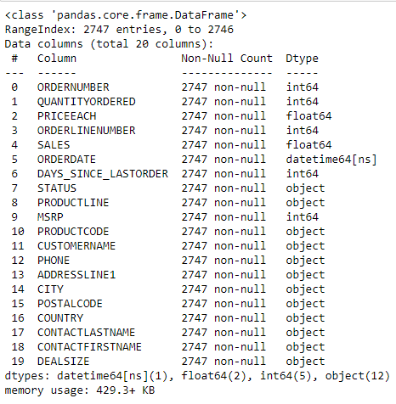
DATA ANALYSIS
Data Shape:
Data Info:
The Dataset has 2747 instances with 19 attributes with 1 of type date time, 5 integer type, 2 float type and rest 12 are categorical type.
Data does not having any null, duplicate or missing values.

Slide 5
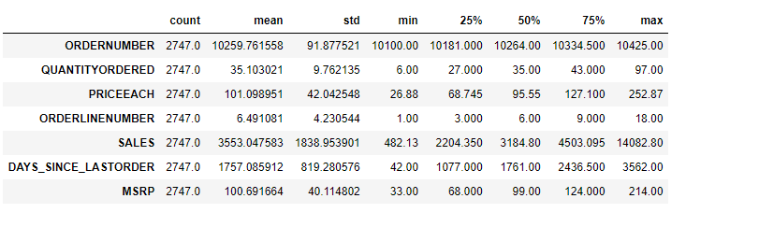
DATA ANALYSIS
Data Summary:

Slide 6
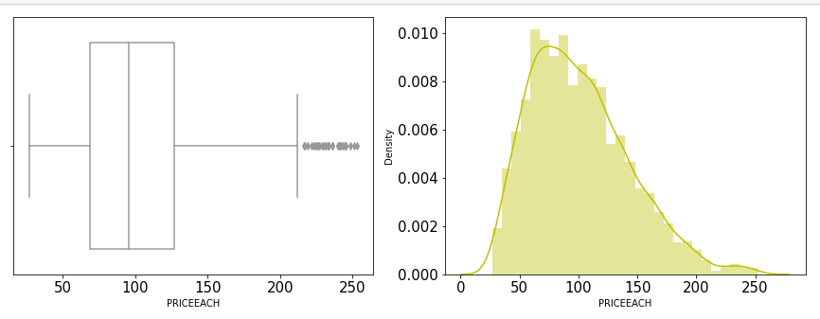
Price of Each Item:
This variable has a lot of outliers and looks slightly right-skewed

Slide 7
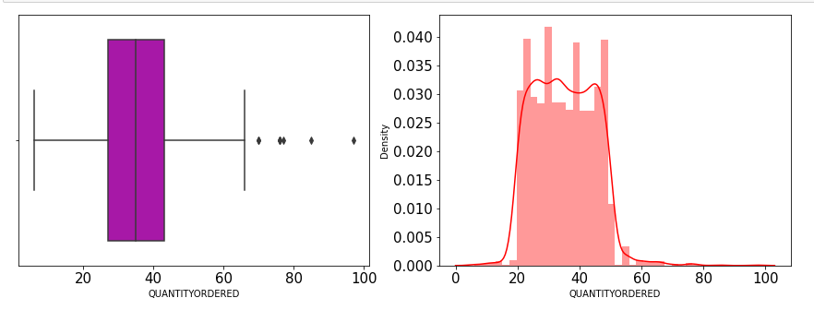
Quantity Ordered:
There are outliers present in the data and the variable is not normally distributed.

Slide 8
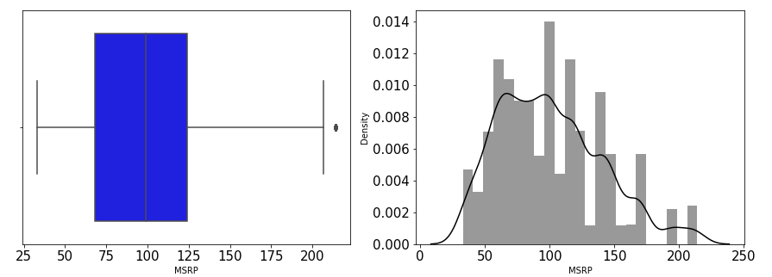
MSRP: Manufacturer’s suggested Retail Price
This variable has very few outliers present.

Slide 9
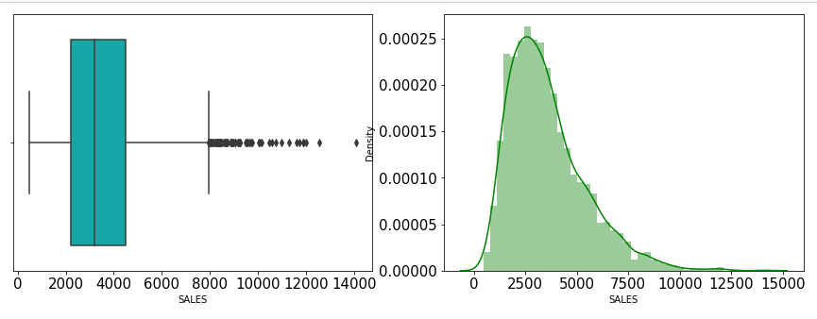
SALES:
This variable is skewed to right and has a lot of outliers

Slide 10
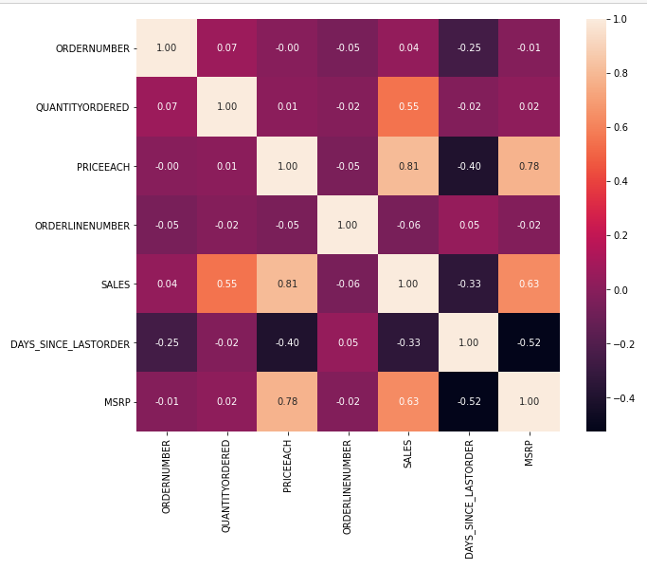
Correlation-Heat Map
High Correlated variables are:
SALES & PRICEEACH
MSRP & PRICEEACH
SALES & QUANTITYORDERED
SALES & MSRP.

Slide 11
Exploratory Data Analysis
Understanding Trends in Data
Visualizing Univariate, Bivariate and Multivariate Graphs through Tableau

Slide 12
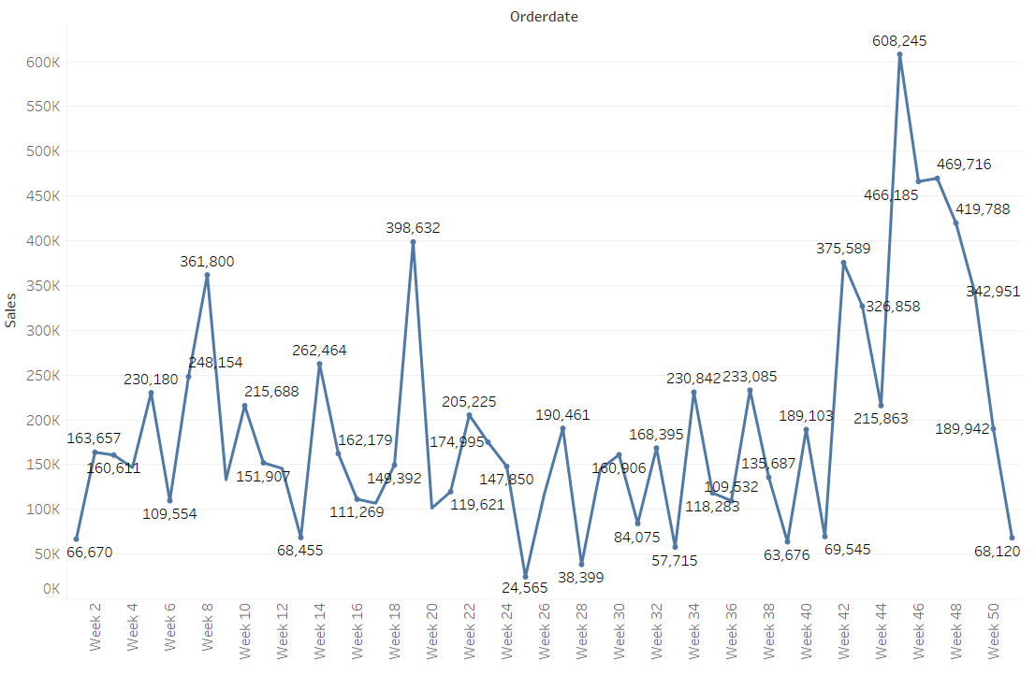
WEEKLY TREND IN SALES
Week 45 shows the highest Sales

Slide 13
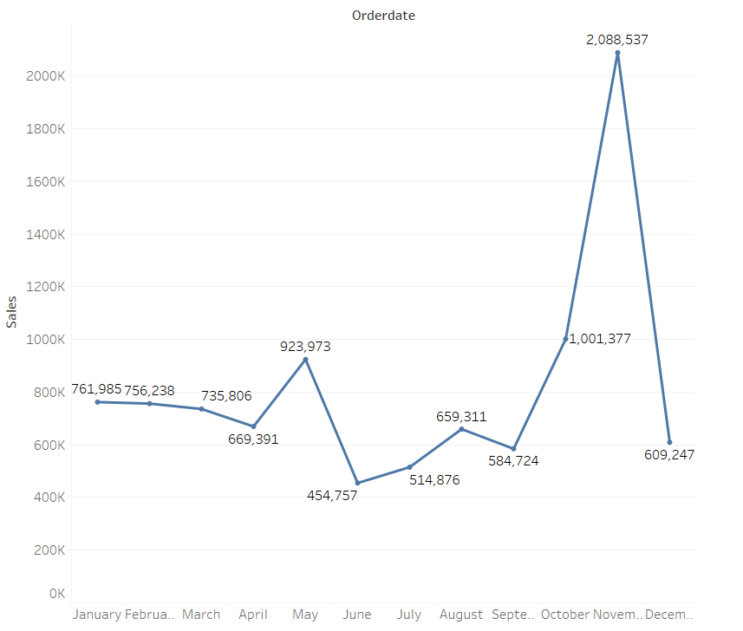
MONTHLY TREND IN SALES
November months gives out the highest Sales

Slide 14
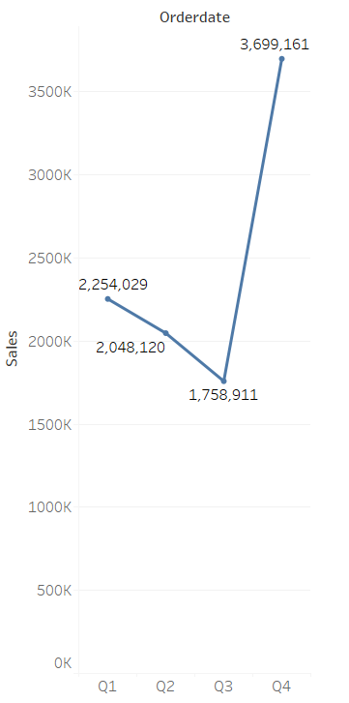
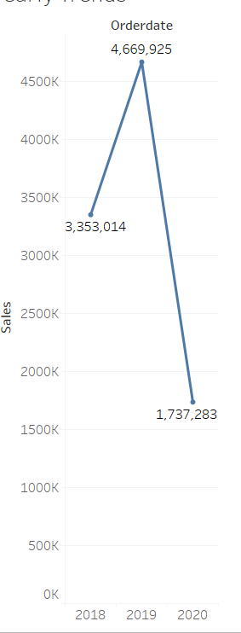
Quarterly Trend in Sales
Yearly Trend in Sales
Sales increased drastically from Q3 to Q4
Year 2019 recorded the highest Sales

Slide 15
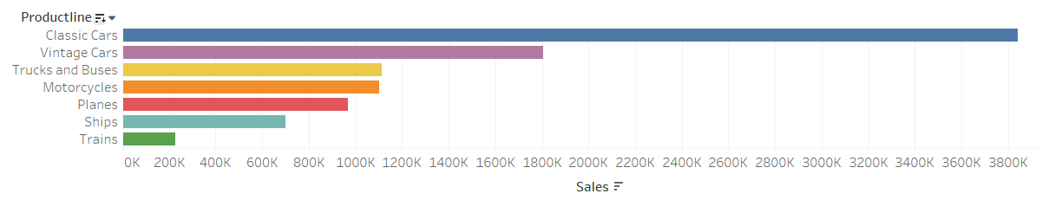
Sales per Product Line

Slide 16
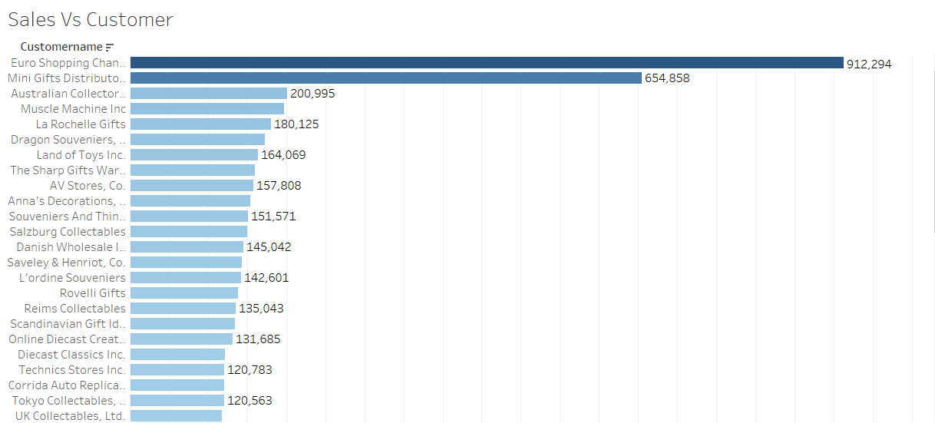
Sales per Customer

Slide 17
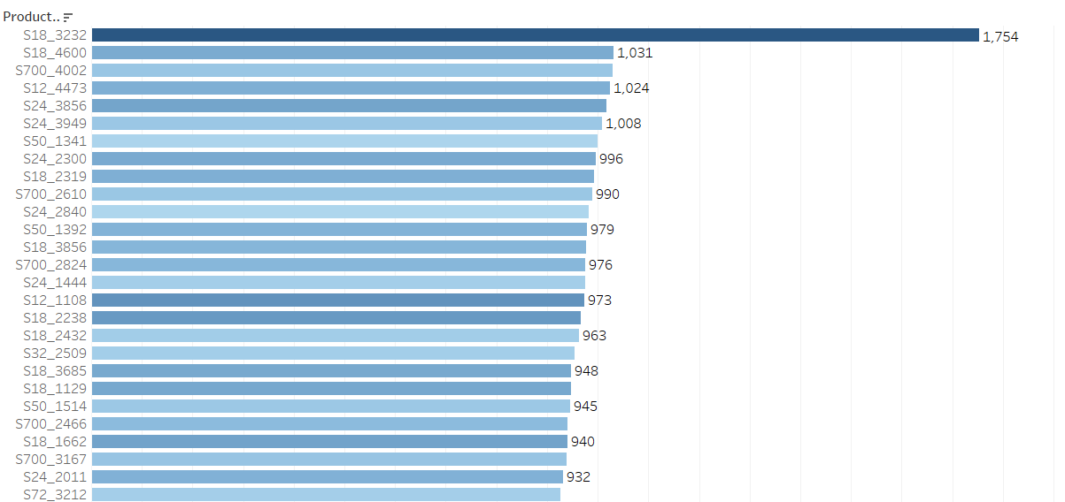

Quantity Ordered Per product and their Sales

Slide 18
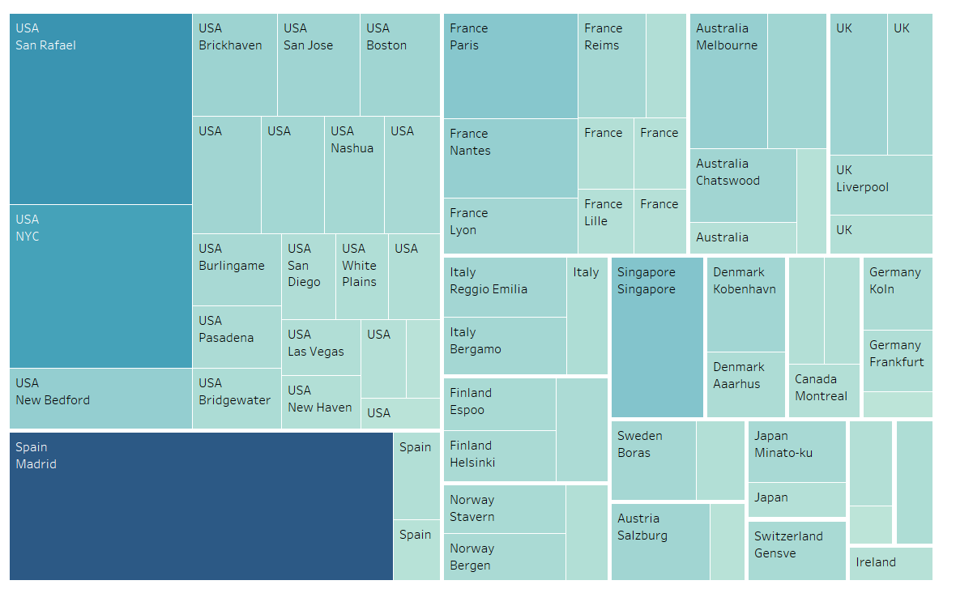
Country-City Wise Sales

Slide 19
Inferences:
City Madrid in country Spain is delivering the highest sales as compared to other cities.
Euro Shopping Channel seems to be the best customer in terms of Sale amount.
Classic Cars is the product line having highest sales.
USA has the highest sales as compared to other countries

Slide 20
Customer Segmentation using RFM Analysis
KNIME tool is Used for RFM analysis & Customer segmentation.
Customer name, Quantity ordered, Price each, Order date, order quantity & Sales are the used parameters.
Predictions:
  Max(order date) – order date] taken as Recency value.
  Count of Quantity orders for a particular customer is taken as Frequency value.
  Sum of Sales made through a particular customer is taken as Monetary value.

Slide 21
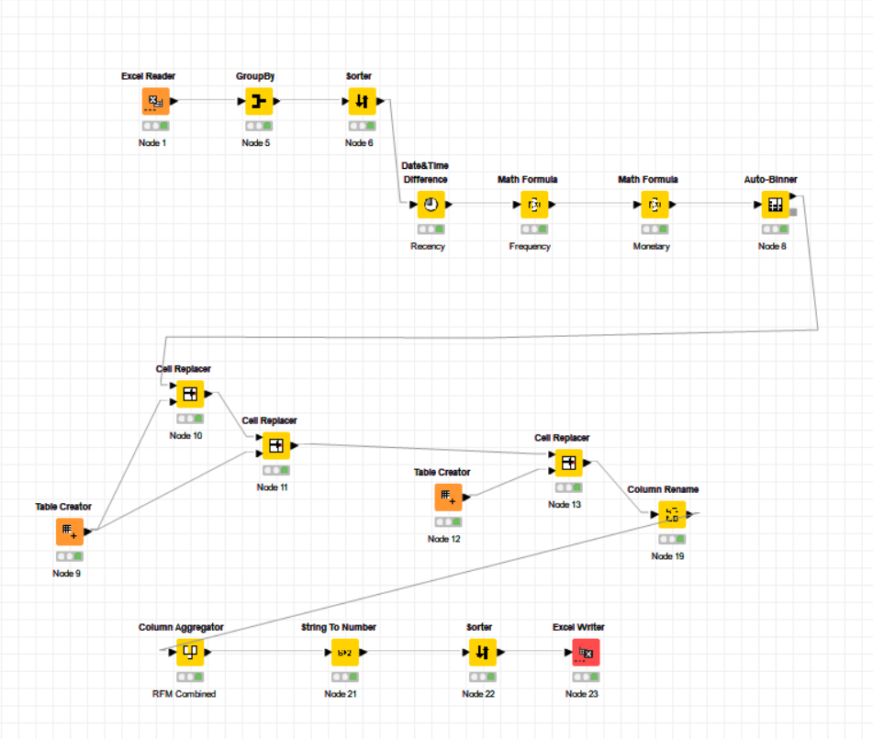
KNIME Workflow

Slide 22
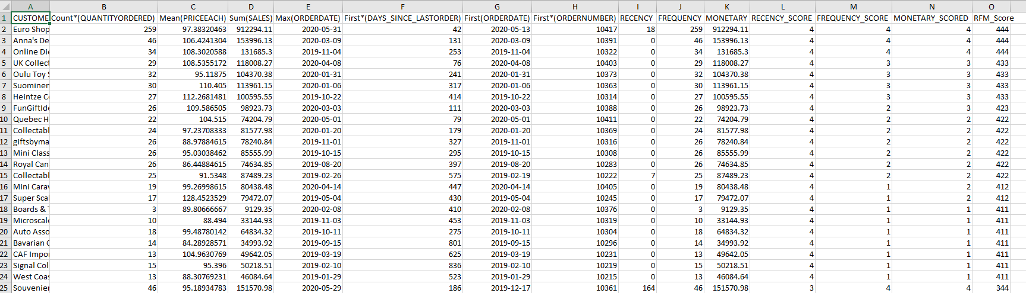
OUTPUT TABLE

Slide 23
Identified Segments from RFM Analysis
Loyal Customers
Euro Shopping Channel , RFM Score 444
Anna's Decorations, Ltd , RFM Score 444
Online Diecast Creations Co. , RFM Score 444
UK Collectables, Ltd. , RFM Score 433
Oulu Toy Supplies, Inc. , RFM Score 433

Slide 24
2. Lost Customers
Auto-Moto Classics Inc. , RFM Score 111
Gift Ideas Corp. , RFM Score 111
Australian Gift Network, Co , RFM Score 111
Mini Auto Werke, RFM Score 111
Oulu Toy Supplies, Inc. , RFM Score 111

Slide 25
3. Best Customers
Euro Shopping Channel , RFM Score 444
Anna's Decorations, Ltd , RFM Score 444
Online Diecast Creations Co. , RFM Score 444
Souveniers And Things Co. , RFM Score 344
Salzburg Collectables , RFM Score 344

Slide 26
4. Customers on the verge of Churning
Land of Toys Inc., RFM Score 144
Muscle Machine Inc, RFM Score 144
Dragon Souveniers, Ltd., RFM Score 144
Reims Collectables, RFM Score 144
Danish Wholesale Imports, RFM Score 144

Slide 27
THANK YOU!!

